Slide 1
Monitoring water saturation variations from seismic noise data : A laboratory controlled experiment
Relationships between seismic velocities ands hydraulic variations

Slide 2
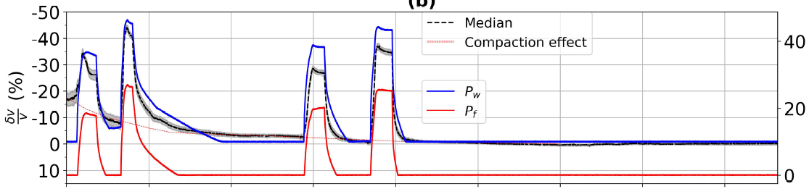
Motivation
Find a rock physics model that could explain the large velocity variations observed during the imbibition/drainage experiments.
Attempt to use the study : Solazzi, S. G., Bodet, L., Holliger, K., & Jougnot, D. (2021). Surface‐wave dispersion in partially saturated soils: the role of capillary forces. Journal of Geophysical Research: Solid Earth, 126(12)
Pressure (mbar)

Slide 3
Outline
Presentation of Solazzi et al. (2021) workflow
Hertz-Mindlin theory to calculate drained soil elastic properties
Bishop and Blight (1963) to include capillary effects in the effective pressure
Biot-Gassmann theory to calculate the saturated soil elastic properties
Van Genuchten (1980) to relate the water saturation to the capillary pressure
Application of the methodology to Thomas’s lab data
Limitations of Hertz-Mindlin → use of modified Walton’s model
Inconsistency between Van Genuchten (1980) saturation profiles and measured saturation profiles

Slide 4
Solazzi et al. (2021) workflow

Slide 5
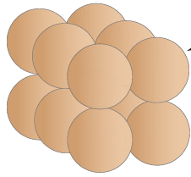
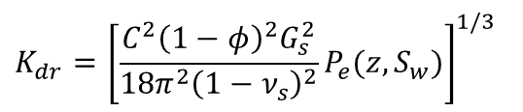
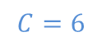
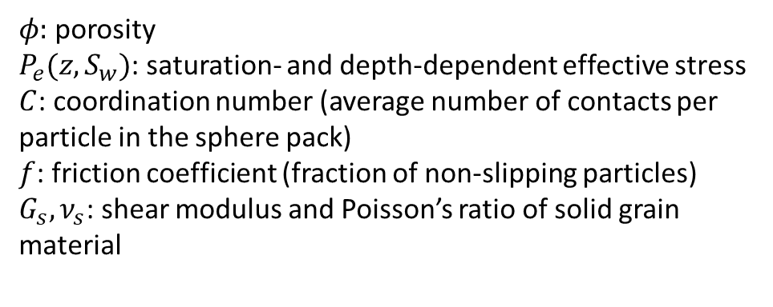
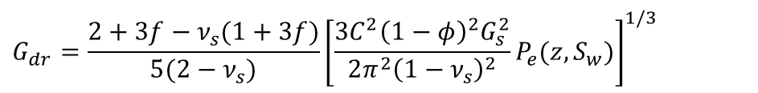
Drained Elastic Moduli
Computed using Hertz-Mindlin contact theory:
$$K_{dr}={\left[\frac{C^{2}{\left(1−φ\right)}^{2}G_{s}^{2}}{18π^{2}{\left(1−ν_{s}\right)}^{2}}P_{e}(z,S_{w})\right]}^{1/3}$$
$$G_{dr}=\frac{2+3f−ν_{s}(1+3f)}{5(2−ν_{s})}{\left[\frac{{3C}^{2}{\left(1−φ\right)}^{2}G_{s}^{2}}{2π^{2}{\left(1−ν_{s}\right)}^{2}}P_{e}(z,S_{w})\right]}^{1/3}$$
$φ:$ porosity
$P_{e}(z,S_{w})$: saturation- and depth-dependent effective stress
$C$: coordination number (average number of contacts per particle in the sphere pack)
$f$: friction coefficient (fraction of non-slipping particles)
$G_{s}, ν_{s}$: shear modulus and Poisson’s ratio of solid grain material
*
*
*
*
*
*
$$C=6$$
Notes:
Eqs.4&5 – Solazzi et al. (2021)

Slide 6
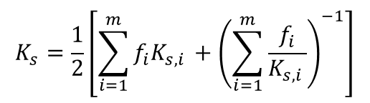
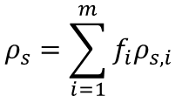
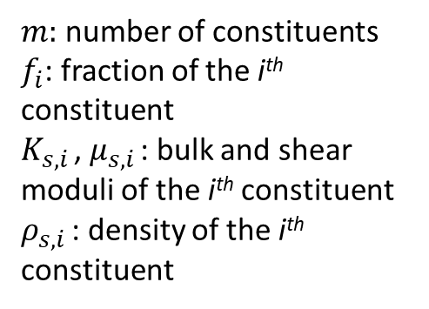
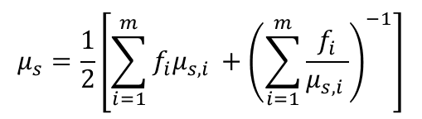
Solid Grain Properties
Solid grain elastic properties computed using Hill’s average (average of Voigt and Reuss bounds):
$$K_{s}=\frac{1}{2}\left[\sum_{i=1}^{m}{f_{i}K_{s,i }}+{\left(\sum_{i=1}^{m}{\frac{f_{i}}{K_{s,i }}}\right)}^{−1}\right]$$
$m:$ number of constituents
$f_{i}$: fraction of the i^{th} constituent
$K_{s,i }$, $μ_{s,i }$: bulk and shear moduli of the i^{th} constituent
$ρ_{s,i }$: density of the i^{th} constituent
$$μ_{s}=\frac{1}{2}\left[\sum_{i=1}^{m}{f_{i}μ_{s,i }}+{\left(\sum_{i=1}^{m}{\frac{f_{i}}{μ_{s,i }}}\right)}^{−1}\right]$$
Density computed using arithmetic mean:
$$ρ_{s}=\sum_{i=1}^{m}{f_{i}ρ_{s,i }}$$
Notes:
Eq.7 – Solazzi et al. (2021)

Slide 7
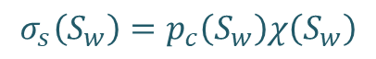
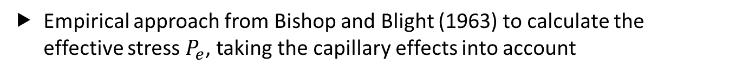
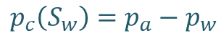
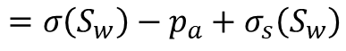
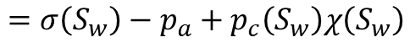
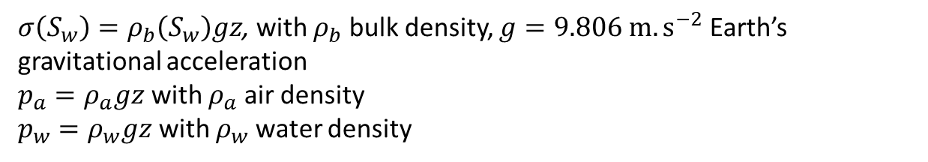
Capillary Effects on Effective Stress
Empirical approach from Bishop and Blight (1963) to calculate the effective stress $P_{e}$, taking the capillary effects into account
$$P_{e}\left(S_{w}\right)=σ\left(S_{w}\right)−p_{a}\left[1−χ\left(S_{w}\right)\right]−p_{w}χ\left(S_{w}\right)$$
Overburden stress
Effective stress parameter
$$=σ\left(S_{w}\right)−p_{a}+p_{c}\left(S_{w}\right)χ\left(S_{w}\right)$$
$$p_{c}\left(S_{w}\right)=p_{a}−p_{w}$$
Capillary pressure
$$=σ\left(S_{w}\right)−p_{a}+σ_{s}\left(S_{w}\right)$$
$$σ_{s}\left(S_{w}\right)=p_{c}\left(S_{w}\right)χ\left(S_{w}\right)$$
Capillary suction stress
$σ\left(S_{w}\right)=ρ_{b}\left(S_{w}\right)gz$, with $ρ_{b}$ bulk density, $g=9.806 m.s^{−2}$ Earth’s gravitational acceleration
$p_{a}=ρ_{a}gz$ with $ρ_{a}$ air density
$p_{w}=ρ_{w}gz$ with $ρ_{w}$ water density
Notes:
Eq.8 – Solazzi et al. (2021)

Slide 8
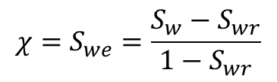
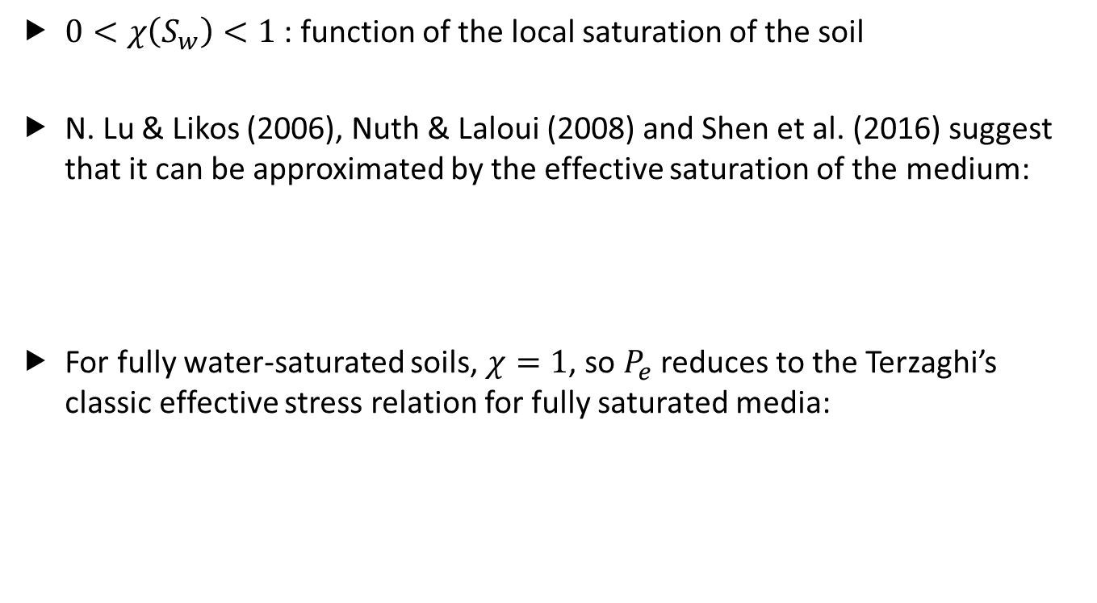
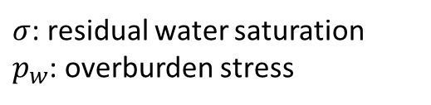
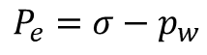
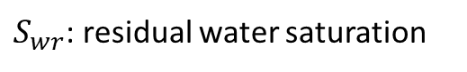
Effective Stress Parameter
$0<χ\left(S_{w}\right)<1$ : function of the local saturation of the soil
N. Lu & Likos (2006), Nuth & Laloui (2008) and Shen et al. (2016) suggest that it can be approximated by the effective saturation of the medium:
For fully water-saturated soils, $χ=1$, so $P_{e}$ reduces to the Terzaghi’s classic effective stress relation for fully saturated media:
$$χ=S_{we}=\frac{S_{w}−S_{wr}}{1−S_{wr}}$$
$S_{wr}$: residual water saturation
$σ$: residual water saturation
$p_{w}$: overburden stress
$$P_{e}=σ−p_{w}$$

Slide 9
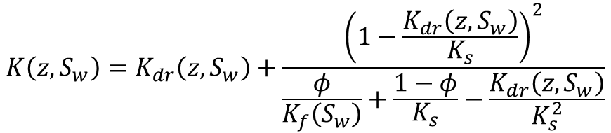
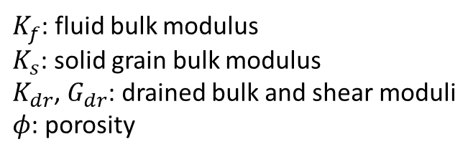
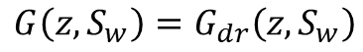
Saturated Properties
Saturated properties calculated using Gassmann (1951) equations
Assumptions:
All pores are connected
Pore fluid pressure is equilibrated throughout the pore space
Medium is monosaturated
$$K\left(z,S_{w}\right)=K_{dr}\left(z,S_{w}\right)+\frac{{\left(1−\frac{K_{dr}\left(z,S_{w}\right)}{K_{s}}\right)}^{2}}{\frac{φ}{K_{f}\left(S_{w}\right)}+\frac{1−φ}{K_{s}}−\frac{K_{dr}\left(z,S_{w}\right)}{K_{s}^{2}}}$$
$$G\left(z,S_{w}\right)=G_{dr}\left(z,S_{w}\right)$$
$K_{f}$: fluid bulk modulus
$K_{s}$: solid grain bulk modulus
$K_{dr}$, $G_{dr}$: drained bulk and shear moduli
$φ$: porosity
Notes:
Eqs.9&10 – Solazzi et al. (2021)

Slide 10
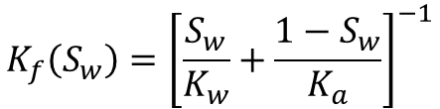
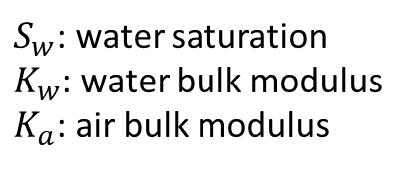
Fluid Bulk Modulus
Calculated using Wood’s equation
Assumption:
Frequency is low enough so that internal fluid pressure gradients generated by a passing wave have time to equilibrate during a half-cycle.
$$K_{f}\left(S_{w}\right)={\left[\frac{S_{w}}{K_{w}}+\frac{1−S_{w}}{K_{a}}\right]}^{−1}$$
$S_{w}$: water saturation
$K_{w}$: water bulk modulus
$K_{a}$: air bulk modulus
Notes:
Eq.11 – Solazzi et al. (2021)

Slide 11
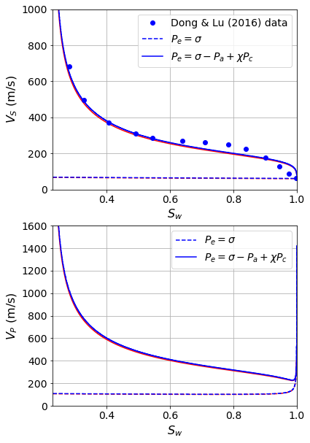

Capillary Effects on $V_{P}$ and $V_{S}$ Results and Interpretation
Missouri Clay
The model that includes the effect of capillary forces (solid lines) correctly captures the increase of Vs with decreasing saturation, which cannot explained by using solely Biot-Gassmann (dashed lines).
The increase of Vp and Vs with decreasing saturation is attributed to the stiffening effect of capillary forces.
―: predictions from Solazzi et al. (2021)
―: predictions from current code
Notes:
05/09/2021 : Solazzi_et_al_Model_Fig3.ipynb
See p.9 of Solazzi et al. (2021) for the interpretation.
Check experimental conditions in Dong and Lu (2016)

Slide 12
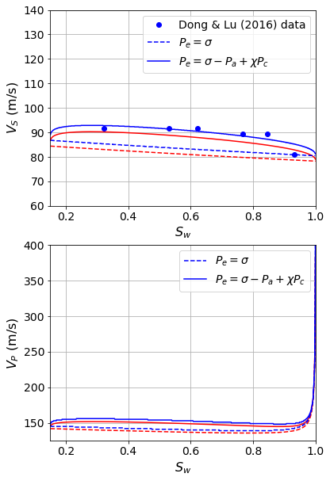
Capillary Effects on $V_{P}$ and $V_{S}$ Results and Interpretation
Esperance Sand
The model that includes the effect of capillary forces (solid lines) better fits Dong & Lu (2016) data.
The stiffening effect of capillary pressure is not as pronounced as for the Missouri clay case. This may be due to the fact that capillary suction effects on Vp and Vs decrease as soil texture becomes coarser.
―: predictions from Solazzi et al. (2021)
―: predictions from current code
Notes:
05/09/2021 : Solazzi_et_al_Model_Fig3.ipynb
See p.9 of Solazzi et al. (2021) for the interpretation.

Slide 13

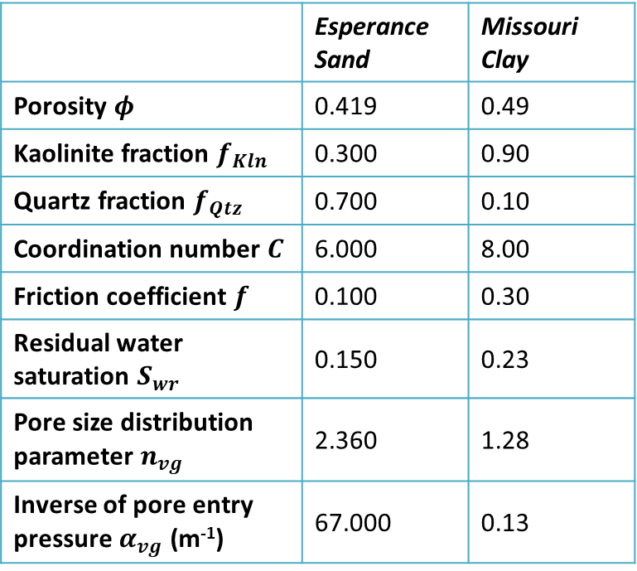
Capillary Effects on $V_{P}$ and $V_{S}$ Input parameters
 | Esperance Sand | Missouri Clay
Porosity $φ$ | 0.419 | 0.49
Kaolinite fraction $f_{Kln}$ | 0.300 | 0.90
Quartz fraction $f_{Qtz}$ | 0.700 | 0.10
Coordination number $C$ | 6.000 | 8.00
Friction coefficient $f$ | 0.100 | 0.30
Residual water saturation $S_{wr}$ | 0.150 | 0.23
Pore size distribution parameter $n_{vg}$ | 2.360 | 1.28
Inverse of pore entry pressure $α_{vg}$ (m⁻¹) | 67.000 | 0.13
Parameters of the van Genuchten (1980) model that best fit Dong and Lu (2016) data and used to model capillary effects
Notes:
VG : used to compute the hydraulic pressure head from Swe, then $P_{c}=−hρ_{w}g$
Section 3.1 of the paper – Table 1
van Genuchten model: Eq.14
02/09/2021 : Solazzi_et_al_Model_Fig3.ipynb

Slide 14
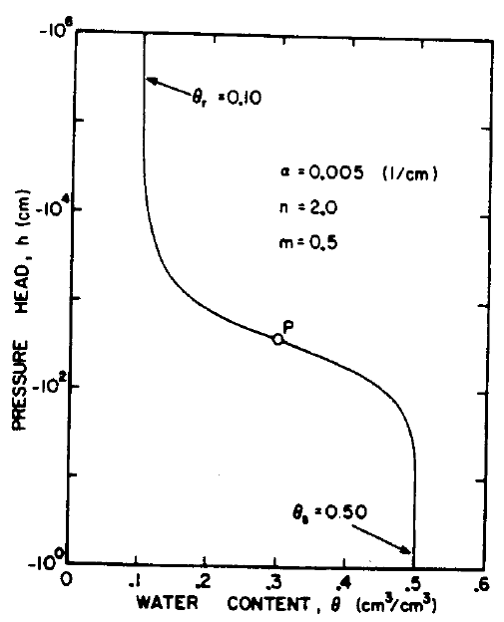
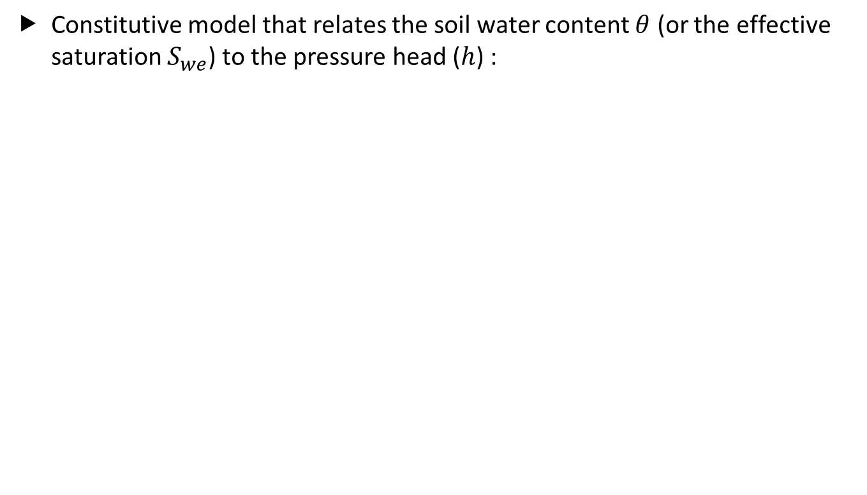
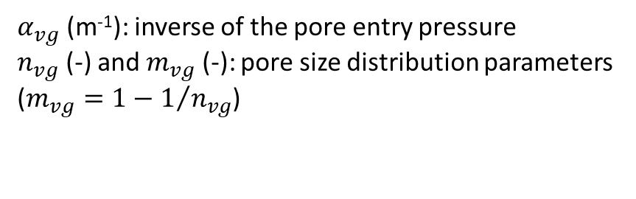
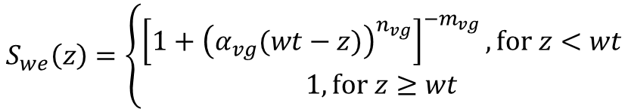
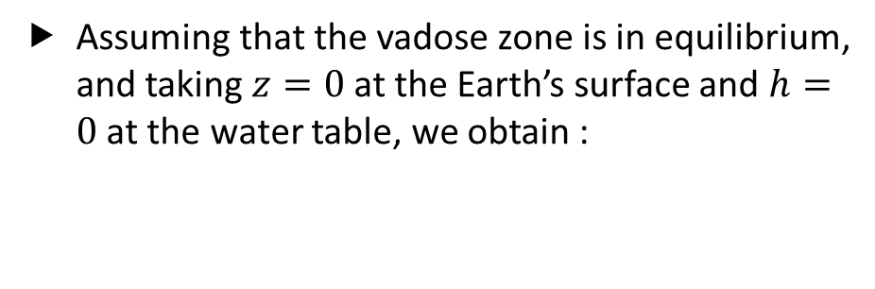
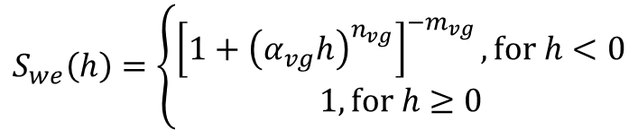
Van Genuchten (1980) model
Constitutive model that relates the soil water content $θ$ (or the effective saturation $S_{we}$) to the pressure head ($h$) :
$$S_{we}\left(h\right)=\left\{\begin{matrix}{\left[1+{\left(α_{vg}h\right)}^{n_{vg}}\right]}^{−m_{vg}}, \text{f}\text{or} h<0 \\ 1, \text{for} h≥0\end{matrix}\right.$$
$α_{vg}$ (m⁻¹): inverse of the pore entry pressure
$n_{vg}$ (-) and $m_{vg}$ (-): pore size distribution parameters ($m_{vg}=1−1/{n_{vg}}$)
Assuming that the vadose zone is in equilibrium, and taking $z=0$ at the Earth’s surface and $h=0$ at the water table, we obtain :
$$S_{we}\left(z\right)=\left\{\begin{matrix}{\left[1+{\left(α_{vg}(wt−z)\right)}^{n_{vg}}\right]}^{−m_{vg}}, \text{f}\text{or} z<wt \\ 1, \text{for} z≥wt\end{matrix}\right.$$
Notes:
Inverse of the pore entry pressure: value related to the air pressure needed to displace the water from the larger pore sizes.
$P_{c}=−hρ_{w}g$ (used for Missouri clay and Esperance sand examples)

Slide 15
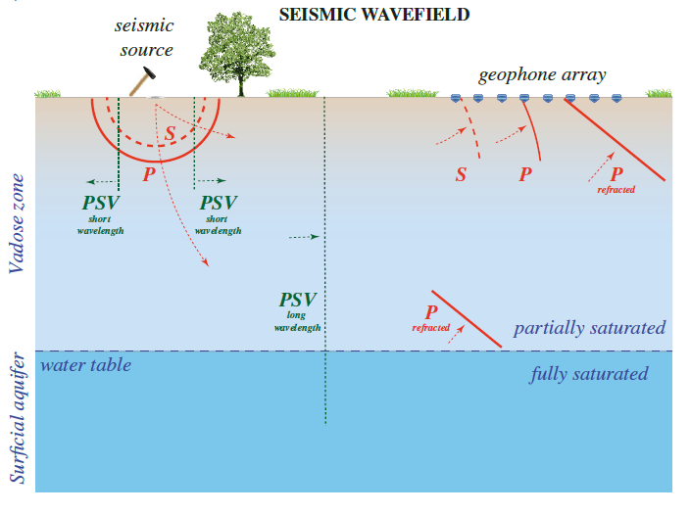
Capillary Effects on Surface Wave Dispersion
192-m-long, 2-m-spaced
 | Sandy Clay
Porosity | 0.38
Gulf clay fraction | 0.43
Quartz fraction | 0.57
Coordination number | 8
Friction coefficient | 0.3
Residual water saturation | 0.26
Pore size distribution parameter | 1.23
Inverse of pore entry (m⁻¹) | 2.7
Sandy clay soil
25 m
Notes:
05/09/2021 : Solazzi_et_al_Model_Fig3.ipynb
See p.10 of Solazzi et al. (2021) , Fig1c and Table 1

Slide 16
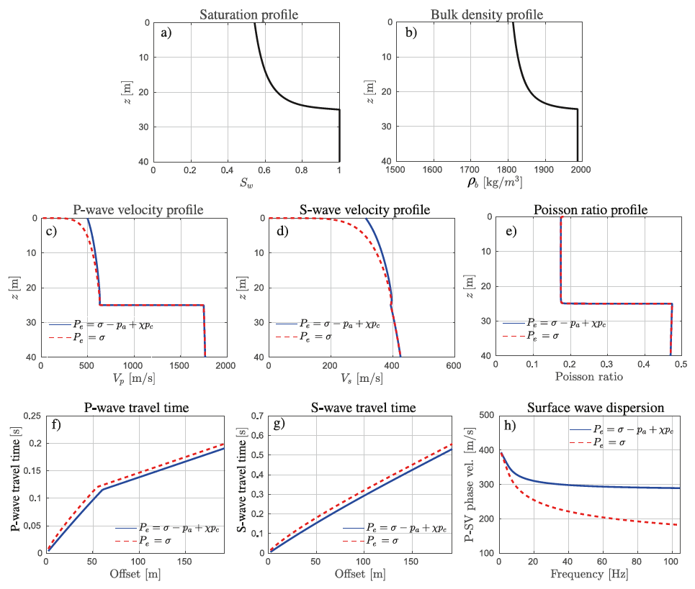
Capillary Effects on Surface Wave Dispersion
Notes:
05/09/2021 : Solazzi_et_al_Model_Fig3.ipynb
See p.10 of Solazzi et al. (2021) , Fig1c and Table 1

Slide 17
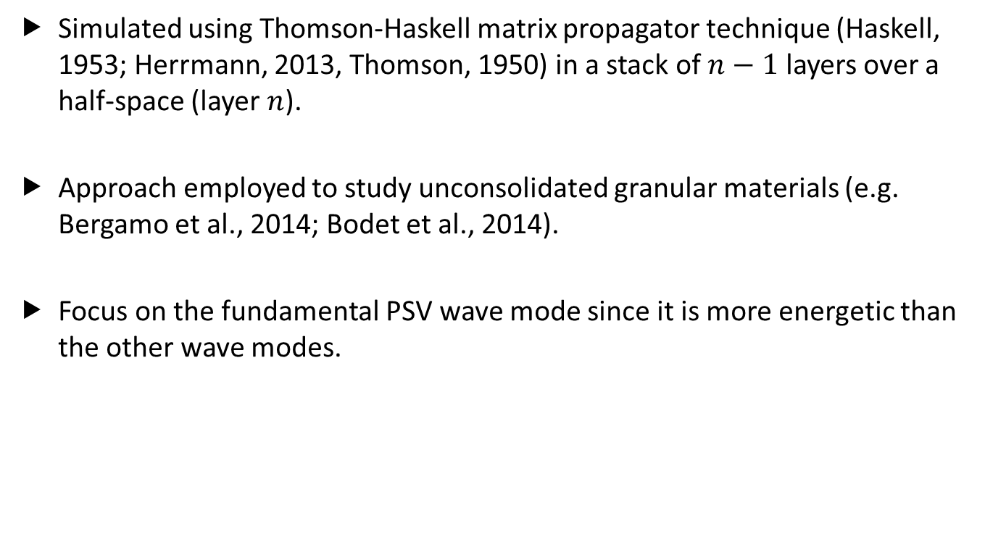
Rayleigh Wave Dispersion Curves
Simulated using Thomson-Haskell matrix propagator technique (Haskell, 1953; Herrmann, 2013, Thomson, 1950) in a stack of $n−1$ layers over a half-space (layer $n$).
Approach employed to study unconsolidated granular materials (e.g. Bergamo et al., 2014; Bodet et al., 2014).
Focus on the fundamental PSV wave mode since it is more energetic than the other wave modes.

Slide 18
Application to Landes Sand

Slide 19
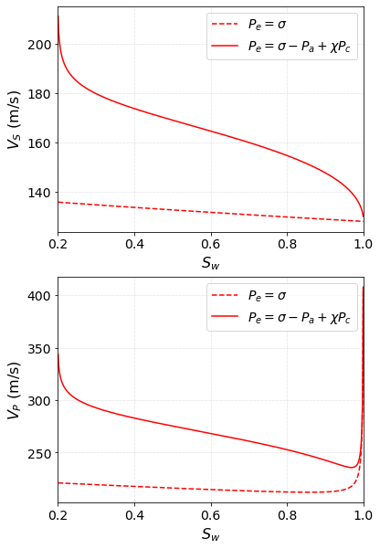
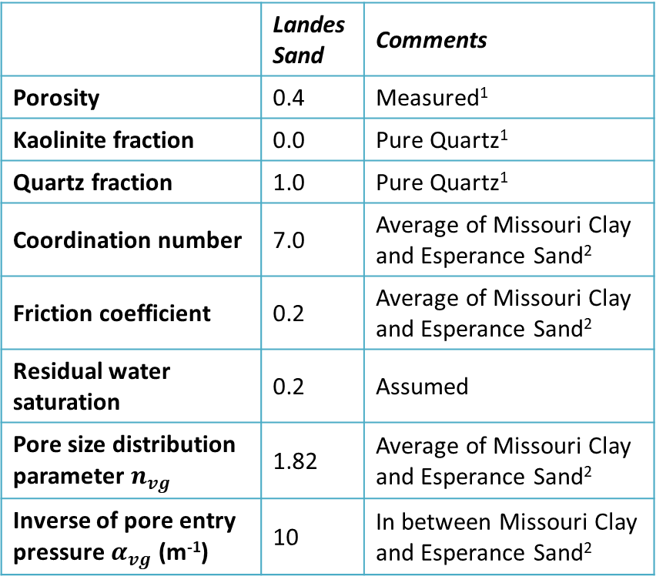
Capillary Effects on $V_{P}$ and $V_{S}$ Input parameters
 | Landes Sand | Comments
Porosity | 0.4 | Measured¹
Kaolinite fraction | 0.0 | Pure Quartz¹
Quartz fraction | 1.0 | Pure Quartz¹
Coordination number | 7.0 | Average of Missouri Clay and Esperance Sand²
Friction coefficient | 0.2 | Average of Missouri Clay and Esperance Sand²
Residual water saturation | 0.2 | Assumed
Pore size distribution parameter $n_{vg}$ | 1.82 | Average of Missouri Clay and Esperance Sand²
Inverse of pore entry pressure $α_{vg}$ (m⁻¹) | 10 | In between Missouri Clay and Esperance Sand²
¹: Barrière et al., JGI 2012; ²: Solazzi et al., JGR 2021
Notes:
21/09/2022 : Solazzi_et_al_Model_Landes_sand.ipynb

Slide 20
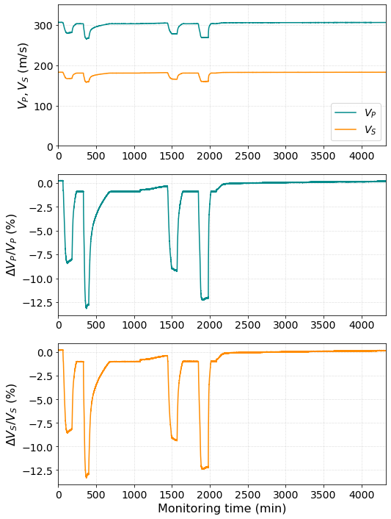
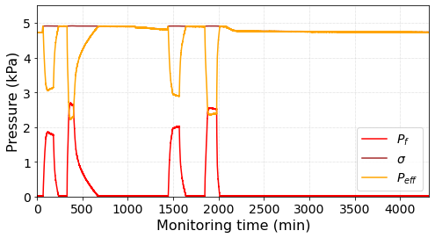
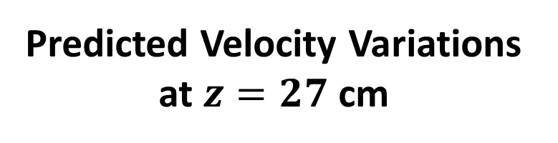
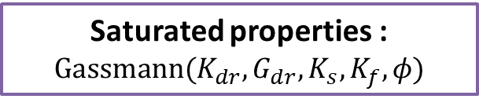
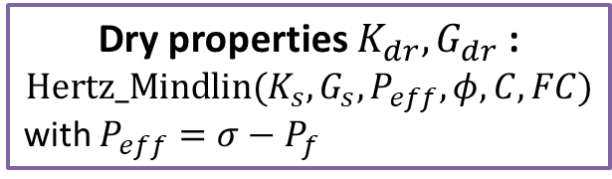
Predicted Velocity Variations at $z=27$ cm
Predicted velocities using the following workflow :
Dry properties $K_{dr}, G_{dr}$:
$$\text{Hertz}\text{_}\text{Mindlin}(K_{s}, G_{s}, P_{eff},φ,C,FC)$$
with $P_{eff}=σ−P_{f}$
Saturated properties :
$$\text{G}\text{assmann}(K_{dr}, G_{dr}, K_{s},K_{f},φ)$$
Notes:
03/10/2022 - HydroData_Thomas_v1.ipynb
Error in code. Not integrating the density log.

Slide 21
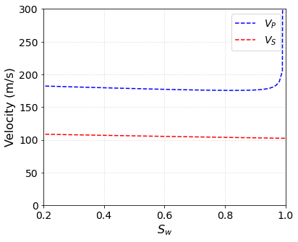
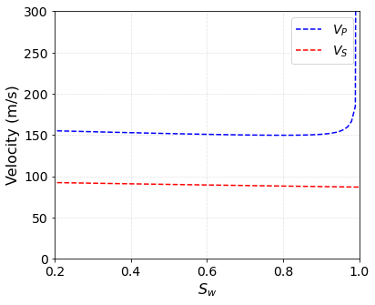
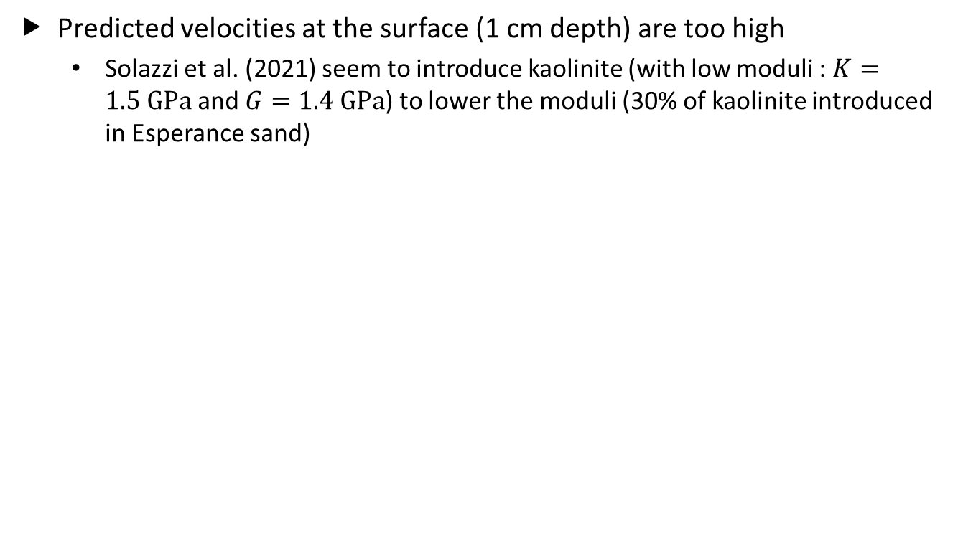
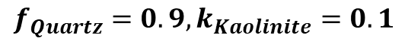
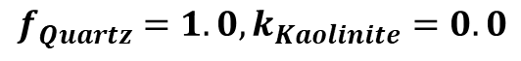
Limitations of Hertz-Mindlin Model
Predicted velocities at the surface (1 cm depth) are too high
Solazzi et al. (2021) seem to introduce kaolinite (with low moduli : $K=1.5 \text{GPa}$ and $G=1.4 \text{GPa}$) to lower the moduli (30% of kaolinite introduced in Esperance sand)
$$f_{Quartz}=1.0, k_{Kaolinite}=0.0$$
$$f_{Quartz}=0.9, k_{Kaolinite}=0.1$$
Notes:
03/10/2022 - HydroData_Thomas_v1.ipynb

Slide 22





Hertz-Mindlin vs Walton Models
An alternative to Hertz-Mindlin model for a random packing of spheres is Walton (1987) model, for which it is assumed that the “normal and shear deformation of a two-grain combination occur simultaneously”.
$$K_{dr}=\frac{1}{6}{\left[\frac{3{\left(1−φ_{0}\right)}^{2}C^{2}P_{e}}{π^{4}C_{s}^{2}}\right]}^{1/3}$$
$φ_{0}$: porosity of the random packing at $P_{e}=0$
$C_{s}$: compliance parameter defined as $C_{s}=\frac{1}{4π}\left(\frac{1}{G_{s}}+\frac{1}{K_{s}+{G_{s}}/3}\right)$
$G_{dr}={RK}_{dr}$ where $\frac{3}{5}≤R≤\frac{18}{5}\left(\frac{K_{s}+G_{s}}{3K_{s}+2G_{s}}\right)$
Notes:
12/10/2022 – HertzMindlin_vs_Walton_models.ipynb
f=0 : no friction between grains (slip between grains)
f=1 : perfect adhesion between grains (slip between grains)

Slide 23




Modified Walton Model (Pride, 2005)
Experimental observations on natural sands (Hardin and Richart, 1963; Domenico, 1977) :
$K_{dr}$, $G_{dr}$ increase in $P_{e}^{1/2}$ for $P_{e}<P_{0}$,
$K_{dr}$, $G_{dr}$ increase in $P_{e}^{1/3}$ for $P_{e}>P_{0}$,
where $P_{0}$ is on the order of 10 MPa.
Walton’s model was modified by Pride (2005) to account for the material dilatation occurring at low pressures :
For $P_{e}≪P_{0}$, $K_{dr}=\frac{1}{6}{\left[\frac{3{\left(1−φ_{0}\right)}^{2}C_{0}^{2}P_{0}}{π^{4}C_{s}^{2}}\right]}^{1/3}\frac{{\left(\frac{P_{e}}{P_{0}}\right)}^{1/2}}{{\left[1+{\left(\frac{16P_{e}}{9P_{0}}\right)}^{4}\right]}^{1/24}}$
$P_{0}$: pressure beyond which $C=C_{0}$ and no new contacts are created.
Notes:
12/10/2022 – HertzMindlin_vs_Walton_models.ipynb
See Eq.(9.53) Pride (2005).

Slide 24



Modified Walton Model (Pride, 2005)
For lower pressures (kPa range, which is the range of interest for the lab experiment), the modified version decreases the moduli significantly.
The range of drained bulk modulus is now consistent with $K_{dr}=0.025 \text{GPa}$ computed in Barrière et al. (2012).
Notes:
12/10/2022 – HertzMindlin_vs_Walton_models.ipynb

Slide 25



Predicted Velocity Variations at $z=27$ cm
Predicted velocities using the modified Walton model:
Dry properties $K_{dr}, G_{dr}$:
$$\text{M}\text{ofidied} \text{Walton}(K_{s}, G_{s}, P_{eff},P_{0},φ,C_{0},R)$$
with $P_{eff}=σ−P_{f}$
Saturated properties :
$$\text{G}\text{assmann}(K_{dr}, G_{dr}, K_{s},K_{f},φ)$$
Notes:
13/10/2022 - HydroData_Thomas_v2.ipynb
Velocities are more consistent with what is observed compared with velocities obtained using Hertz-Mindlin workflow.

Slide 26


Predicted Velocity Variations at $z=27$ cm
Predicted velocities using the modified Walton model:
Dry properties $K_{dr}, G_{dr}$:
$$\text{M}\text{ofidied} \text{Walton}(K_{s}, G_{s}, P_{eff},P_{0},φ,C_{0},R)$$
with $P_{eff}=σ−P_{f}$
Saturated properties :
$$\text{G}\text{assmann}(K_{dr}, G_{dr}, K_{s},K_{f},φ)$$
Notes:
28/10/2022 - HydroData_Thomas_v2.ipynb
Velocities are more consistent with what is observed compared with velocities obtained using Hertz-Mindlin workflow.

Slide 27





Predicted Velocity Variations at $z=27$ cm
Predicted velocities without taking $P_{f}$ into account:
Dry properties $K_{dr}, G_{dr}$:
$$\text{Mofidied} \text{Walton}(K_{s}, G_{s}, P_{eff},P_{0},φ,C_{0},R)$$
with $P_{eff}=σ$, $z=27 \text{cm}$
Saturated properties :
$$\text{G}\text{assmann}(K_{dr}, G_{dr}, K_{s},K_{f},φ)$$
Notes:
26/10/2022 - HydroData_Thomas_v2.ipynb
Error in code. Not integrating the density log.

Slide 28


Predicted Velocity Variations at $z=27$ cm
Predicted velocities without taking $P_{f}$ into account:
Dry properties $K_{dr}, G_{dr}$:
$$\text{Mofidied} \text{Walton}(K_{s}, G_{s}, P_{eff},P_{0},φ,C_{0},R)$$
with $P_{eff}=σ$, $z=27 \text{cm}$
Saturated properties :
$$\text{G}\text{assmann}(K_{dr}, G_{dr}, K_{s},K_{f},φ)$$
Notes:
28/10/2022 - HydroData_Thomas_v2.ipynb

Slide 29

Including versus Excluding Pressure Effects
$\text{Mofidied} \text{Walton}(K_{s}, G_{s}, P_{eff},P_{0},φ,C_{0},R)$ with $P_{eff}=σ−P_{f}$, $\text{Gassmann}(K_{dr}, G_{dr}, K_{s},K_{f},φ)$
Velocity variations governed by pressure changes ➔ Larger velocity variations
$\text{Mofidied} \text{Walton}(K_{s}, G_{s}, P_{eff},P_{0},φ,C_{0},R)$ with $P_{eff}=σ$, $\text{Gassmann}(K_{dr}, G_{dr}, K_{s},K_{f},φ)$
Velocity variations governed by saturation changes ➔ Smaller velocity variations
Notes:
27/10/2022 - HydroData_Thomas_v2.ipynb
Error in code. Not integrating the density log.

Slide 30


Getting estimates of the pore pressure as a function of depth
So far, we have been looking at the velocity variations as a function of time at a particular depth ($z=27 \text{cm}$), for which $P_{f}$ is measured.
To investigate the velocity variations as a function of depth and time, we need estimates of $P_{f}$.
One idea was to use the saturation profiles to invert for the Van Genuchten’s parameters.

Slide 31



Saturation Profiles
$α_{vg}$ ↑
Saturation for a given time sample
Average saturation for the time interval
Water table depth
Saturation predicted using VG model for $α_{vg}=[0.1;1;10]$, $n_{vg}=1.82$, $S_{wr}=0.2$
Notes:
05/10/2022 - HydroData_Thomas_v1.ipynb

Slide 32
Summary
Taking pressure effects into account (using the measured pressure), we could explain up to approximately 35% P- and S-wave velocity variations.
Solazzi et al. (2021) provide some possible lines of approach to infer the velocity variations using rock physics.
The modified Walton’s model may however be better suited for the pressures we deal with in the laboratory.
We need to further investigate whether/how we can use Van Genuchten model to infer the capillary pressure from the saturation.

Slide 33
Appendix : Solazzi Results

Slide 34




Capillary Effects on $V_{P}$ and $V_{S}$ Pressures
Missouri Clay
Esperance Sand
Air pressure $P_{a}$ : $P_{a}=ρ_{a}gz$
Capillary pressure : $P_{c}=−hρ_{w}g≈−P_{w}$
$$σ−P_{a}+χP_{c}>σ ⇒P_{a}+χP_{c}>0$$
Notes:
26/10/2022 : Solazzi_et_al_Model_Fig3.ipynb
See discussion below eq. 13 for Pc

Slide 35



Capillary Effects on $V_{P}$ and $V_{S}$ Results
Missouri Clay
Esperance Sand
―: predictions from Solazzi et al. (2021)
―: predictions from current code
Notes:
10/12/2021 : Solazzi_et_al_Model_Fig3.ipynb
Mistake in computation of Swe from Sw and Swr

Slide 36
Capillary Effects on $V_{P}$ and $V_{S}$ Results
Missouri Clay
Esperance Sand
―: predictions from Solazzi et al. (2021)
―: predictions from current code
Notes:
02/09/2021 : Solazzi_et_al_Model_Fig3.ipynb
Predictions from current code almost match the predictions from Solazzi et al. (2021) for Missouri Clay.
Discrepancies observed for Esperance Sand

Slide 37




Capillary Effects on $V_{P}$ and $V_{S}$
Esperance Sand
$$G_{qrtz}=40 GPa$$
Esperance Sand
$$G_{qrtz}=36 GPa$$
―: predictions from Solazzi et al. (2021)
―: predictions from current code
Notes:
02/09/2021 : Solazzi_et_al_Model_Fig3.ipynb
Taking a different value for the mineral shear modulus improves the consistancy between the current code and predictions from Solazzi et al. (2021). Wrong input parameters?

Slide 38




Capillary Effects on $V_{P}$ and $V_{S}$ Sensitivity to Coordination Number $C$
Coordination numbers ranging from 5 to 11
Original value: $C=7$
Esperance Sand: $C=6$
Missouri Clay: $C=8$
Only affects the magnitude of the velocities
Notes:
21/09/2022 : Solazzi_et_al_Model_Landes_sand.ipynb
Mavko p.234

Slide 39



Capillary Effects on $V_{P}$ and $V_{S}$ Sensitivity to Friction Coefficient $FC$
Friction coefficients ranging from 0 to 0.3
Original value: $FC=0.2$
Esperance Sand: $FC=0.1$
Missouri Clay: $FC=0.3$
Only affects the magnitudes of the velocities
Notes:
22/09/2022 : Solazzi_et_al_Model_Landes_sand.ipynb
F=0 : no friction between the grains
F=1 : perfect adhesion between the grains
Esperance Sand : F=0.1
Missouri Clay : F=0.3

Slide 40



Capillary Effects on $V_{P}$ and $V_{S}$ Sensitivity to Pore Size Distribution Parameter $n_{vg}$
Pore size distribution parameter ranging from 1.5 to 2.25
Original value: $n_{vg}=1.82$
Esperance Sand: $n_{vg}=2.36$
Missouri Clay: $n_{vg}=1.28$
Key parameter governing the velocity-saturation trend
Notes:
22/09/2022 : Solazzi_et_al_Model_Landes_sand.ipynb
Esperance Sand: 2.36
Missouri Clay: 1.28

Slide 41



Capillary Effects on $V_{P}$ and $V_{S}$ Sensitivity to Pore Entry Pressure $α_{vg}$
Pore size entry pressure ranging from 0.1 to 100 m⁻¹ (in log scale)
Original value: $α_{vg}=10 m^{−1}$
Esperance Sand: $α_{vg}=0.13 m^{−1}$
Missouri Clay: $α_{vg}=67 m^{−1}$
Also affects the velocity-water saturation trend. Might be to lesser extent than the pore size distribution.
Notes:
22/09/2022 : Solazzi_et_al_Model_Landes_sand.ipynb
Esperance Sand: 0.13
Missouri Clay: 67

Slide 42


Capillary Effects on $V_{P}$ and $V_{S}$ Sensitivity to Pore Size Distribution Parameter $n_{vg}$
Pore size distribution parameter ranging from 1.5 to 2.25
Original value: $n_{vg}=1.82$
Esperance Sand: $n_{vg}=2.36$
Missouri Clay: $n_{vg}=1.28$
Notes:
27/09/2022 : Solazzi_et_al_Model_SensitivitySw2VanGenuchtenParam.ipynb

Slide 43


Capillary Effects on $V_{P}$ and $V_{S}$ Sensitivity to Pore Entry Pressure $α_{vg}$
Pore size entry pressure ranging from 0.1 to 100 m⁻¹ (in log scale)
Original value: $α_{vg}=10 m^{−1}$
Esperance Sand: $α_{vg}=67 m^{−1}$
Missouri Clay: $α_{vg}=0.13 m^{−1}$
Notes:
22/09/2022 : Solazzi_et_al_Model_Landes_sand.ipynb
Esperance Sand: 67
Missouri Clay: 0.13

Slide 44



Pressure Data
Pressure sensors at depths $z=28 cm$ and $z=54 cm$
Comparison with hydrostatic pore pressure
Full saturation never seems to be attained, as expected.
Shallow sensor seems to measure the capillary pressure rather than the water column weight.
Computation of overburden stress $σ$ and effective pressure $P_{eff}$
Notes:
30/09/2022 - HydroData_Thomas_v1.ipynb
Peff = P - Swe*Pf: not convinced this is correct

Slide 45




Pressure Data
Pressure sensors at depths $z=28 cm$ and $z=54 cm$ (solid lines) compared to hydrostatic pore pressure assuming full saturation (dotted lines).
The coloured areas show the hydrostatic pore pressure assuming that the pores are filled with an effective homogeneous fluid with density.
Minimum bound :
Maximum bound :
$P_{p,min}=\left(\sum_{i=2}^{N}{S_{w_{i−1}}}\left(z_{i}−z_{i−1}\right)\right)ρ_{w}g$
$P_{p,max}=\left(S_{w_{1}}z_{1}+\sum_{i=2}^{N}{S_{w_{i}}}\left(z_{i}−z_{i−1}\right)\right)ρ_{w}g$
Notes:
19/10/2022 - HydroData_Thomas_v2.ipynb

Slide 46







Pressure Data
Predictions using initial $S_{w}$
Predictions clipping $S_{w}$ to 0.8
Predictions removing 0.05 to $S_{w}$
Predictions removing 0.1 to $S_{w}$
Notes:
19/10/2022 - HydroData_Thomas_v2.ipynb

Slide 47



Predicted Velocity Variations at $z=27$ cm
Predicted velocities using the following workflow :
Dry properties $K_{dr}, G_{dr}$:
$$\text{M}\text{ofidied} \text{Walton}(K_{s}, G_{s}, P_{eff},P_{0},φ,C_{0},R)$$
with $P_{eff}=P_{eff}=σ−S_{we}P_{f}$
Saturated properties :
$$\text{G}\text{assmann}(K_{dr}, G_{dr}, K_{s},K_{f},φ)$$
Notes:
13/10/2022 - HydroData_Thomas_v2.ipynb
Velocities are more consistent with what is observed compared with velocities obtained using Hertz-Mindlin workflow.

Slide 48



Predicted Velocity Variations at $z=27$ cm
Predicted velocities using the following workflow :
Dry properties $K_{dr}, G_{dr}$:
$$\text{Hertz}\text{_}\text{Mindlin}(K_{s}, G_{s}, P_{eff},φ,C,FC)$$
avec $P_{eff}=σ−S_{we}P_{f}$
Saturated properties :
$$\text{G}\text{assmann}(K_{dr}, G_{dr}, K_{s},K_{f},φ)$$
Notes:
30/09/2022 - HydroData_Thomas_v1.ipynb
Peff = P - Swe*Pf: not convinced this is correct

Slide 49



Predicted Velocity Variations
Predicted velocities using the following workflow :
Dry properties $K_{dr}, G_{dr}$:
$$\text{Mofidied} \text{Walton}(K_{s}, G_{s}, P_{eff},P_{0},φ,C_{0},R)$$
with $P_{eff}=σ$, $z=1 \text{mm}$
Saturated properties :
$$\text{G}\text{assmann}(K_{dr}, G_{dr}, K_{s},K_{f},φ)$$
Notes:
26/10/2022 - HydroData_Thomas_v2.ipynb

Slide 50

Limitations of Hertz-Mindlin Model
Porosity has little impact on the predicted velocities
# Input Param
Sw = 0.5 # Water saturation (-)
z = 1*1e-3 # Depth (m)
# Mineral properties
K_Qz = 45 #GPa
G_Qz = 36 #GPa
rho_Qz = 2.6 #g/cc
K_Ka = 1.5 #GPa
G_Ka = 1.4 #GPa
rho_Ka = 1.58 #g/cc
f_Qz = 1.0 #unitless
# Fluid properties
Kw = 2.3 #GPa
rho_w = 1.0 #g/cc
Ka = 1e-4 #GPa
rho_a = 1e-3 #g/cc
# Rock matrix properties
phi = np.linspace(0,0.45,100)
C = 6 #Coordination number - Esperance Sand (Solazzi et al., JGR 2021)
FC = 0.1 #Friction coefficient - Esperance Sand (Solazzi et al., JGR 2021)
Swr = 0.2 #Residual water saturation (to confirm with Thomas)
Notes:
03/10/2022 - HydroData_Thomas_v1.ipynb
C and FC from Esperance Sand seem to be more appropriate than avg of Esperance Sand and Missouri Clay

Slide 51




Modified Walton vs Hertz-Mindlin Model
Predicted velocities at the surface (1 cm depth) are too low?
Velocities should be around 150 m/s at the surface or at 17 cm depth?
$$z=1 \text{cm}$$
$$z=17 \text{cm}$$
Notes:
13/10/2022 - HydroData_Thomas_v2.ipynb

Slide 52

Saturation Profiles
Saturation for a given time sample
Average saturation for the time interval
Water table depth
Notes:
05/10/2022 - HydroData_Thomas_v1.ipynb

Slide 53


Saturation Profiles
$α_{vg}$ ↑
Saturation for a given time sample
Average saturation for the time interval
Water table depth
Saturation predicted using VG model for $α_{vg}=[0.1;1;10]$, $n_{vg}=1.82$, $S_{wr}=0.15$
Notes:
07/10/2022 - HydroData_Thomas_v1.ipynb

Slide 54
Appendix : Hertz-Mindlin model

Slide 55


Hertz-Mindlin model – Contact stiffnesses and effective moduli
Effective elastic properties of normal $S_{n}$ and tangential $S_{t}$ contact stiffnesses of a two-particle combination:
$S_{n}=\frac{∂F}{∂δ}$ and $S_{t}=\frac{∂T}{∂τ}$
where:
$F$ and $T$ are the normal and tangential forces;
$δ$ and $τ$ are the normal and tangential displacements.
For a random sphere packing, effective bulk and shear moduli $K_{eff}$ and $μ_{eff}$ are expressed as:
$K_{eff}=\frac{C(1−φ)}{12πR}S_{n}$ and $μ_{eff}=\frac{C\left(1−φ\right)}{20πR}(S_{n}+1.5S_{t})$
where:
$φ$ is the porosity;
$C$ is the coordination number;
$R$ is the sphere radius.
Notes:
Rock Physics Handbook - Mavko

Slide 56

Hertz-Mindlin model – Hertz model
The Hertz model describes the normal compression of two identical spheres when a hydrostatic confining pressure $P$ is applied to a random, identical-sphere packing.
The normal force is $F=\frac{4πR^{2}P}{C(1−φ)}$.
The normal stiffness is $S_{n}=\frac{4μa}{1−ν}$,
where:
$a=R{\left[\frac{3π\left(1−ν\right)}{2C\left(1−φ\right)μ}P\right]}^{1/3}$ is the radius of the contact area,
$μ$ and $ν$ are the shear modulus and Poisson’s ratio of the grain material.
The effective bulk modulus of a dry, random, identical-sphere packing is:
$K_{eff}={\left[\frac{C^{2}{\left(1−φ\right)}^{2}μ^{2}}{18π^{2}{\left(1−ν\right)}^{2}}P\right]}^{1/3}$.
Notes:
Rock Physics Handbook - Mavko

Slide 57

Hertz-Mindlin model – Contribution of Mindlin (1949)
Mindlin (1949) shows that if the spheres are first pressed together and a tangential force is applied afterward, slip may occur at the edges of the contact.
The extent of the slip depends on the coefficient of friction $η$ between the spheres in contact.
The shear stiffness is given by:
$S_{t}=\frac{8aμ{\left(1−{F_{t}}/{ηF_{n}}\right)}^{1/3}}{2−ν}$ for $F_{t}≤ηF_{n}$
where:
$a$ is the radius of the contact area,
$F_{n}$ and $F_{t}$ are the normal and tangential forces applied to the spheres,
$μ$ and $ν$ are the shear modulus and Poisson’s ratio of the grains.
Notes:
Rock Physics Handbook - Mavko

Slide 58

Hertz-Mindlin model – Contribution of Mindlin (1949)
For acoustic wave propagation, the normal force $F_{n}$ due to the overburden pressure is much larger than the tangential force $F_{t}$ generated by the propagating wave, hence:
$S_{t}=\frac{8aμ}{2−ν}$ and $S_{n}=\frac{4aμ}{1−ν}$ (same as Hertz).
The effective shear modulus of a dry, random, identical-sphere packing is:
$μ_{eff}=\frac{5−4ν}{5(2−ν)}{\left[\frac{{3C}^{2}{\left(1−φ\right)}^{2}μ^{2}}{2π^{2}{\left(1−ν\right)}^{2}}P\right]}^{1/3}$.
The effective bulk modulus of a dry, random, identical-sphere remains the same as the one given by Hertz theory:
$K_{eff}={\left[\frac{C^{2}{\left(1−φ\right)}^{2}μ^{2}}{18π^{2}{\left(1−ν\right)}^{2}}P\right]}^{1/3}$.
The Hertz–Mindlin model can be used to describe the properties of precompacted granular rocks.
Notes:
Rock Physics Handbook - Mavko

Slide 59

Hertz-Mindlin model – Frictionless spheres
In the case of absolutely frictionless spheres,
the friction coefficient tends to 0: $η→0$,
${F_{t}}/{ηF_{n}}→1$,
the tangential stiffness $S_{t}$ tends to 0.
The effective bulk and shear moduli of the packing become:
$K_{eff}=\frac{C(1−φ)}{12πR}S_{n} \text{and} μ_{eff}=\frac{C\left(1−φ\right)}{20πR}S_{n}$.
Note that $S_{n}$ can still be expressed using Hertz model. Hence, for a pack of frictionless spheres:
$K_{eff}={\left[\frac{C^{2}{\left(1−φ\right)}^{2}μ^{2}}{18π^{2}{\left(1−ν\right)}^{2}}P\right]}^{1/3}$ and $μ_{eff}=\frac{2−ν}{5(2−ν)}{\left[\frac{{3C}^{2}{\left(1−φ\right)}^{2}μ^{2}}{2π^{2}{\left(1−ν\right)}^{2}}P\right]}^{1/3}$.
Notes:
Rock Physics Handbook - Mavko

Slide 60

Hertz-Mindlin model – Fraction of no-slip contacts parameter
Unconsolidated sandstones might be a mixture of frictionless grains and grains in perfect adhesion. To account for this, a friction parameter $f$ can be introduced:
$f=0$: no friction between any of the grains;
$f=1$: all grains are in perfect adhesion.
The bulk modulus remains unaffected by this parameter:
$K_{eff}={\left[\frac{C^{2}{\left(1−φ\right)}^{2}μ^{2}}{18π^{2}{\left(1−ν\right)}^{2}}P\right]}^{1/3}$.
The shear modulus of the pack becomes:
$μ_{eff}=\frac{2+3f−ν(1+3f)}{5(2−ν)}{\left[\frac{{3C}^{2}{\left(1−φ\right)}^{2}μ^{2}}{2π^{2}{\left(1−ν\right)}^{2}}P\right]}^{1/3}$.
Plot Geff as a function of different porosity for different values of f
Notes:
Rock Physics Handbook - Mavko

Slide 61


Hertz-Mindlin model – Grain angularity
The non-uniformity of the grain contacts due to the grain geometry can be taken into account through the grain angularity parameter $R^{′}={\overline{R}}/R$.
Bulk and shear moduli of a pack of spheres with non-uniform grain contacts can be expressed as (Bachrach and Avseth, 2008):
$K_{HM}={\left[\frac{C^{2}R′{\left(1−φ_{c}\right)}^{2}G_{m}^{2}}{18π^{2}{\left(1−ν_{m}\right)}^{2}}P_{eff}\right]}^{\frac{1}{3}}$ and
$G_{HM}=\frac{2+3f−ν_{m}(1+3f)}{5(2−ν_{m})}{\left[\frac{{3C}^{2}R′{\left(1−φ_{c}\right)}^{2}G_{m}^{2}}{2π^{2}{\left(1−ν_{m}\right)}^{2}}P_{eff}\right]}^{\frac{1}{3}}$ .
In RockSI, default values are $f=1$ and $R^{′}=1$.
Notes:
Eq. are equivalent to eq. 18 of Bachrach and Avseth (2008)

Slide 62

Coordination number and porosity
Coordination number increases with decreasing porosity
Notes:
Rock Physics Handbook – Mavko – Chapter 5

Slide 63

Coordination number and porosity
Power-law relationship from Garcia and Medina (2006)
$$C=C_{0}+9.7{\left(φ_{0}−φ\right)}^{0.48}$$
where:
$C:$ coordination number
$φ:$ porosity
$C_{0}=4.46$ and $φ_{0}=0.384$
Relationship based on fitting data from numerical simulations of granular media.
Does not seem consistent with experimental data shown in Figure 5.1.1.
Power-law relationship from Makse et al. (2004)
$$C=C_{0}+9.7{\left(φ_{0}−φ\right)}^{0.48}$$
where $C_{0}=6$ and $φ_{0}=0.48$
Relationship from Makse et al. (2004) parallels that of Garcia and Medina (2006) except that it is shifted upward by about 1.5.
Notes:
Rock Physics Handbook - Mavko

Slide 64
Appendix : Comparison between Watlon and Hertz-Mindlin models

Slide 65
Hertz-Mindlin vs Walton Models
No difference between both models
Notes:
12/10/2022 – HertzMindlin_vs_Walton_models.ipynb

Slide 66
Modified Walton Model (Pride, 2005)
Walton’s model was modified by Pride (2005) to account for the material dilatation occurring at low pressures.
Notes:
12/10/2022 – HertzMindlin_vs_Walton_models.ipynb
See Eq.(9.53) Pride (2005).

Slide 67

Modified Walton Model (Pride, 2005)
For lower pressures (kPa range, which is the range of interest for the lab experiment), the modified version decreases the moduli significantly.
The range of drained bulk modulus is now consistent with $K_{dr}=0.025 \text{GPa}$ computed from Barrière et al. (2012).
Notes:
12/10/2022 – HertzMindlin_vs_Walton_models.ipynb

